Slide 1
Ternary Heterovalent Alternative Wide Band Gap Semiconductors
K.R. York, R.A. Makin, S.M. Durbin
Western Michigan University
J.P. Mathis, N. Senabulya, Z. Deng, L. Williams, R. Clarke, E. Kioupakis
University of Michigan
P. Miska
Universite de Lorraine
R.J. Reeves
University of Canterbury

Slide 2
Economic and Environmental Considerations
Many current opto-electronic devices are comprised of gallium and indium
Expensive
Sourced through mining
Stability of supply chain uncertain
No reliable recycling infrastructure
Ga
In
Notes:
So many of the current….
<number>

Slide 3
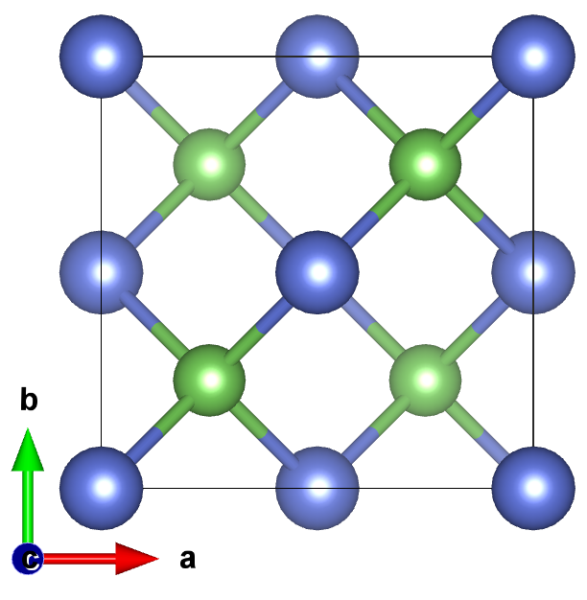
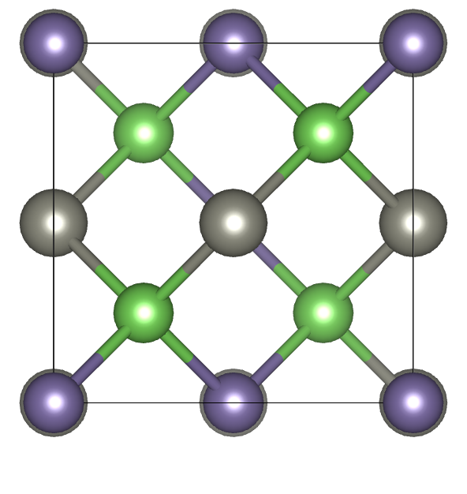
Heterovalent ternary materials
First reports by Goodman et al. in 1956
Largely of interest for nonlinear optics
GaAs
ZnGeAs₂
III-V
II-IV-V₂
Notes:
rRelated to binary analogs
III-V materials related to II-IV-V₂
Phosphides and arsenides: chalcopyrite
Nitrides: orthorhombic
Smaller band gap materials
ZnSnN₂, ZnSnP₂, and ZnGeAs₂
Possibility for alloying
<number>

Slide 4
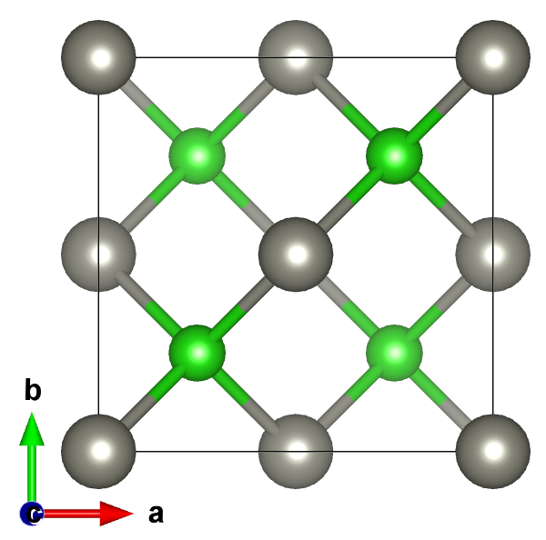
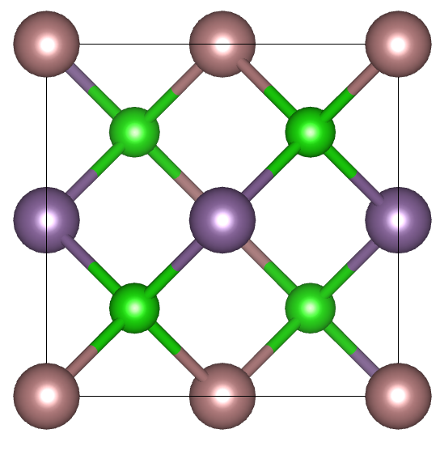
Heterovalent ternary materials
Same concept for I-III-VI₂ materials
CIGS are largely of interest for thin-film PV technologies
ZnSe
CuInSe₂
II-VI
I-III-VI₂
Notes:
Related to binary analogs
III-V materials related to II-IV-V₂
Phosphides and arsenides: chalcopyrite
Nitrides: orthorhombic
Smaller band gap materials
ZnSnN₂, ZnSnP₂, and ZnGeAs₂
Possibility for alloying
<number>

Slide 5
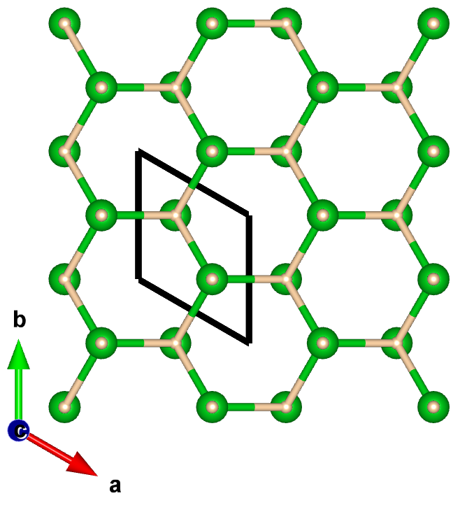
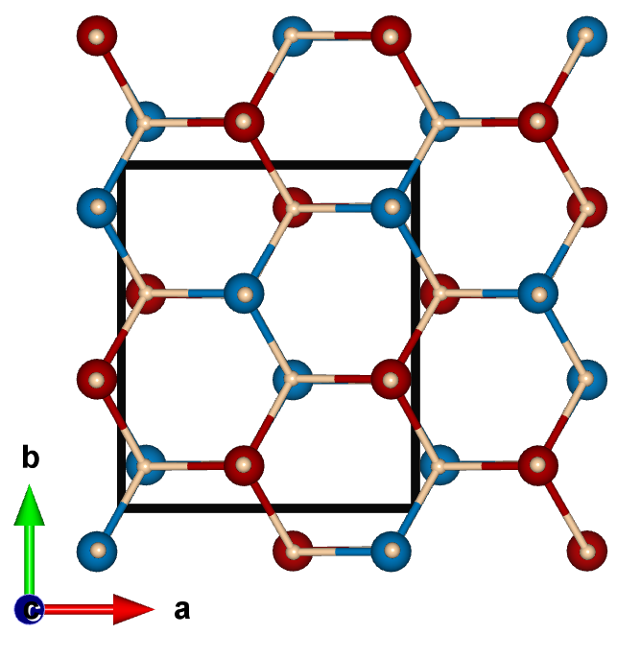
Heterovalent ternary nitrides
First reports of GaN by Pankove et al. in 1971
II-IV-N₂ theoretically stabilizes in an orthorhombic crystal structure
GaN
MgSnN₂
III-N
II-IV-N₂
Notes:
Related to binary analogs
III-V materials related to II-IV-V₂
Phosphides and arsenides: chalcopyrite
Nitrides: orthorhombic
Smaller band gap materials
ZnSnN₂, ZnSnP₂, and ZnGeAs₂
Possibility for alloying
<number>

Slide 6
Mg-IV-N₂ Family
2011 Lambrecht et al. predicted the Zn-IV-N₂
2016 Lambrecht et al. predicted the Mg-IV-N₂
Pna2₁ (number 33) space group
β-NaFeO₂ crystal structure
AlN
MgSiN₂
ZnSiN₂
MgGeN₂
ZnGeN₂
MgSnN₂
GaN
ZnSnN₂
InN
Notes:
B-NaFeO2
III-V materials related to II-IV-V₂
The anion determines structure
Phosphides and arsenides: chalcopyrite
Nitrides: orthorhombic
<number>

Slide 7
Mg-IV-N₂ Family
2011 Lambrecht et al. predicted the Zn-IV-N₂
2016 Lambrecht et al. predicted the Mg-IV-N₂
Pna2₁ (number 33) space group
β-NaFeO₂ crystal structure
AlN
MgSiN₂
ZnSiN₂
MgGeN₂
ZnGeN₂
MgSnN₂
GaN
ZnSnN₂
InN
Notes:
There have been preliminary tests for the band gaps and lattice parameters of some materials in the Mg-IV-N2. For example…
B-NaFeO2 - sub 2
change text
draw circle over MgSnN2 and MgGeN2
III-V materials related to II-IV-V₂
The anion determines structure
Phosphides and arsenides: chalcopyrite
Nitrides: orthorhombic
<number>

Slide 8
Mg-IV-N₂ Family
2011 Lambrecht et al. predicted the Zn-IV-N₂
2016 Lambrecht et al. predicted the Mg-IV-N₂
Pna2₁ (number 33) space group
β-NaFeO₂ crystal structure
AlN
MgSiN₂
ZnSiN₂
MgGeN₂
ZnGeN₂
MgSnN₂
GaN
ZnSnN₂
InN
Notes:
There have been preliminary tests for the band gaps and lattice parameters of some materials in the Mg-IV-N2. For example…
B-NaFeO2 - sub 2
change text
draw circle over MgSnN2 and MgGeN2
III-V materials related to II-IV-V₂
The anion determines structure
Phosphides and arsenides: chalcopyrite
Nitrides: orthorhombic
<number>

Slide 9
Economic and Environmental Considerations
MgSnN₂
Comprised of inexpensive, earth-abundant elements
Mature recycling infrastructure
Theoretical predictions have been made
Never been synthesized
Viable substitute for wide band gap semiconductors?
Ga
In
Sn
Mg
Notes:
<number>

Slide 10
Growth by Molecular Beam Epitaxy (MBE)
Vapor deposition of elements in an ultra-high vacuum environment (10⁻¹⁰ torr)
Source materials are evaporated from the effusion cells
Flux of each element and substrate temperature determine the growth rate
Plasma-assisted MBE:
Nonequilibrium
Thermal evaporation
Aided by a plasma (nitrogen)
Allows real time in-situ electron diffraction measurements
Notes:
How we grow the materials in this work is through
Pictured in this slide is a cut out of the growth chamber where the interaction between the molecular or atomic beams on the heated substrate occurs. The sample block enters the chamber manually from the transfer tube. This keeps out contaminants while having an easy way to load substrates in and take samples out. It also allows us to grow several films without having to bring the system up to atmospheric pressure
(10^-10 torr on same line) and then add the word environment
combine MBE slides and delete this picture
dont need 2nd bullet point
ultra high vacuum
allows real time insitu electron diffraction measurements, last bullet point
<number>

Slide 11
Reflection High-Energy Electron Diffraction (RHEED)
Surface sensitive measurement technique
Used to observe growth of material in-situ
Determine growth rate, crystal quality, lattice parameters, order parameter, and more
Typical RHEED system:
Focused electron source
Phosphor screen
Between 10kV and 20kV
kSA image capture and analysis package
Notes:
The electron source aims an incident beam of electrons at high energies (accelerated to between 10 kV and 20 kV) directed at a low angle q (around 2) to the surface of the sample
RHEED is used to observe the growth of the material in-situ. It can determine the growth rate, crystal quality, lattice parameters, and order parameter. The electron source aims an incident beam of electrons at high energies directed at a low angle theta (around 2 degrees). The high electron energy along with ultra low pressure environment allow the majority of scattering to be in the forward direction. A typical rheed system has...... In-situ rheed images are captured by the charge-coupled device (CCD) camera which is included in the kSA aquisition system
delete clean surface to hold sample -> typical 10kV to 20kV
<number>

Slide 12
Optimizing Growth Parameters
Substrates used yttria-stabilized zirconia:
YSZ(111)
YSZ(100)
Separations between streaks are inversely proportional to the lattice spacing
The desire is that when growth begins the thin, straight streaks will remain
$\left(\overline{1}0\right)\left(00\right)\left(10\right)$
Notes:
order arrangement of atoms
00 order streak
01, 01bar
add crystal directions
add substrate - show picture, explain that using this^
show a poly film
4 different slides - split up these pictures
<number>

Slide 13
Optimizing Growth Parameters
Initial films were polycrystalline
Notes:
order arrangement of atoms
00 order streak
01, 01bar
add crystal directions
add substrate - show picture, explain that using this^
show a poly film
4 different slides - split up these pictures
<number>

Slide 14
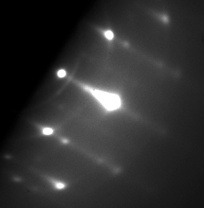
Optimizing Growth Parameters
Initial films were polycrystalline
Problems addressed to achieve high-quality crystal growth
Mg:Sn ratio
Substrate temperature
Lattice mismatch
Notes:
order arrangement of atoms
00 order streak
01, 01bar
add crystal directions
add substrate - show picture, explain that using this^
show a poly film
4 different slides - split up these pictures
<number>

Slide 15
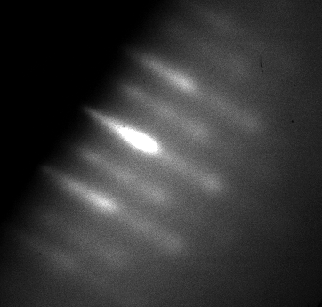
Optimizing Growth Parameters
Initial films were polycrystalline
Problems addressed to achieve high-quality crystal growth
Mg:Sn ratio
Substrate temperature
Lattice mismatch
Notes:
order arrangement of atoms
00 order streak
01, 01bar
add crystal directions
add substrate - show picture, explain that using this^
show a poly film
4 different slides - split up these pictures
<number>

Slide 16
Lattice Parameter Calculations
Local Density Approximation (LDA)
 | a (Å) | b (Å) | c (Å)
LDA | 5.746 | 6.712 | 5.313
A. P. Jaroenjittichai and W. R. L. Lambrecht, “Electronic band structure of MgSnN₂ compounds in the quasiparticle-self-consistent GW approximation,” Phys Rev B, vol. 94, no. 12, 2016.
Notes:
The XRD results, the orthorhombic interplanar spacing equation, and the Bragg equation can be used to calculate the lattice parameters
put reference on slide
walk through these calculations, only show one line at a time
delete error + or -
<number>

Slide 17
Lattice Parameter Calculations
Local Density Approximation (LDA)
Generalized Gradient Approximation (GGA)
 | a (Å) | b (Å) | c (Å)
LDA | 5.746 | 6.712 | 5.313
GGA | 5.932 | 6.905 | 5.499
A. P. Jaroenjittichai and W. R. L. Lambrecht, “Electronic band structure of MgSnN₂ compounds in the quasiparticle-self-consistent GW approximation,” Phys Rev B, vol. 94, no. 12, 2016.
Notes:
The XRD results, the orthorhombic interplanar spacing equation, and the Bragg equation can be used to calculate the lattice parameters
put reference on slide
walk through these calculations, only show one line at a time
delete error + or -
<number>

Slide 18
Lattice Parameter Calculations
Local Density Approximation (LDA)
Generalized Gradient Approximation (GGA)
Experimentally measured lattice constants obtained from XRD results
 | a (Å) | b (Å) | c (Å)
LDA | 5.746 | 6.712 | 5.313
GGA | 5.932 | 6.905 | 5.499
Measured | 5.683 | 6.817 | 5.291
A. P. Jaroenjittichai and W. R. L. Lambrecht, “Electronic band structure of MgSnN₂ compounds in the quasiparticle-self-consistent GW approximation,” Phys Rev B, vol. 94, no. 12, 2016.
Notes:
The XRD results, the orthorhombic interplanar spacing equation, and the Bragg equation can be used to calculate the lattice parameters
put reference on slide
walk through these calculations, only show one line at a time
delete error + or -
<number>

Slide 19
Lattice Parameter Calculations
Local Density Approximation (LDA)
Generalized Gradient Approximation (GGA)
Experimentally measured lattice constants obtained from XRD results
Predicted result closely match experimentally obtained
Confirm the predicted orthorhombic crystal structure
Confirm the predicted lattice constants
 | a (Å) | b (Å) | c (Å)
LDA | 5.746 | 6.712 | 5.313
GGA | 5.932 | 6.905 | 5.499
Measured | 5.683 | 6.817 | 5.291
A. P. Jaroenjittichai and W. R. L. Lambrecht, “Electronic band structure of MgSnN₂ compounds in the quasiparticle-self-consistent GW approximation,” Phys Rev B, vol. 94, no. 12, 2016.
Notes:
The XRD results, the orthorhombic interplanar spacing equation, and the Bragg equation can be used to calculate the lattice parameters
put reference on slide
walk through these calculations, only show one line at a time
delete error + or -
<number>

Slide 20
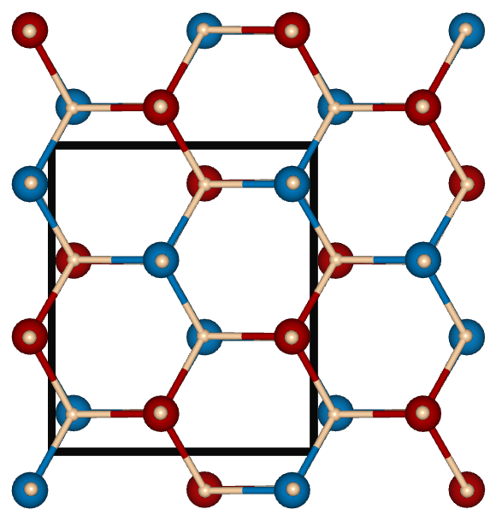
Disorder in the Cation Sublattice
Order Cation Sublattice
Heterovalent ternary nitride belonging to the orthorhombic space group Pna2₁
Red= Mg, Blue = Sn, Tan = N
Notes:
MgSnN2 is a heterovalent ternary nitride that belongs to the orthorhombic space group Pna21. However,...
However, perfectly periodic sublattice...you would ep
<number>

Slide 21
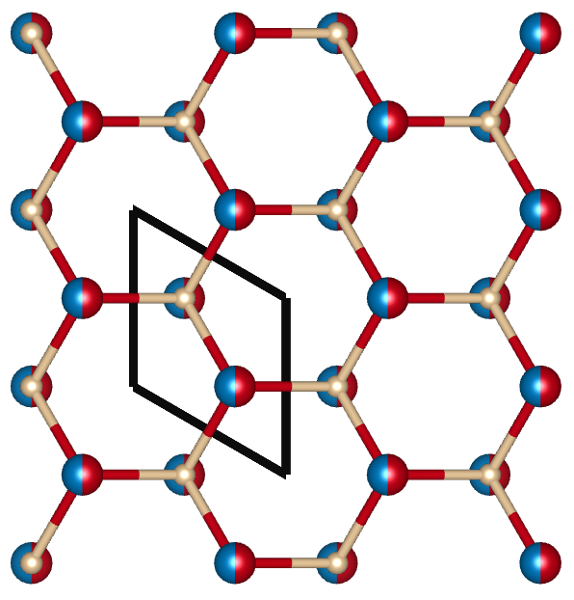
Disorder in the Cation Sublattice
Ordered Cation Sublattice
Disordered Cation Sublattice
Red = Mg, Blue = Sn, Tan = N
Mg and Sn occupy their equilibrium positions
Mg and Sn randomly distributed over cation sites
Varying degrees of cation disorder in between
Notes:
it has been shown that in some heterovalent ternary materials, an increase in disorder in the cation sublattice can lead to an increase in symmetry, resulting in the II-IV-V2 having a wurtzite structure like its analogous III-V materials.
An ordered cation sublattice means that...
A disordered means...
different bullet point
you can have a varying degree
trim down the wording
<number>

Slide 22
Quantifying Disorder
Quantify the degree of ordering through the long-range order parameter S:
the fraction of column-II sites occupied by column-II atoms
the fraction of column-IV sites occupied by column-IV atoms
Stoichiometric samples:=
Can be accessed using Raman spectroscopy, RHEED, or XRD
Notes:
Rethink title, quantifying disorder
Can be accessed using raman spectroscopy
define order parameter (Quantify degree of ordering through the long-range order parameter S)
white out middle graphs at first
put S not S2
can also be done using RHEED and XRD
Show table w order parameter table in final slide,
<number>

Slide 23
Quantifying Disorder
Quantify the degree of ordering through the long-range order parameter S:
Raman spectra: Different features are prominent depending on the structure
Top profile is most alike to the wurtzite crystal structure
S²=0.45
S²=0.60
S²=0.70
S²=0.72
S²=0.74
S²=0.93
Courtesy Prof. Patrice Miska
Notes:
Rethink title, quantifying disorder
Can be accessed using raman spectroscopy
define order parameter (Quantify degree of ordering through the long-range order parameter S)
white out middle graphs at first
put S not S2
can also be done using RHEED and XRD
Show table w order parameter table in final slide,
<number>

Slide 24
Quantifying Disorder
Quantify the degree of ordering through the long-range order parameter S:
Raman spectra: Different features are prominent depending on the structure
Top profile is most alike to the wurtzite crystal structure
Bottom profile most alike to the orthorhombic crystal structure
S²=0.45
S²=0.60
S²=0.70
S²=0.72
S²=0.74
S²=0.93
Courtesy Prof. Patrice Miska
Notes:
Rethink title, quantifying disorder
Can be accessed using raman spectroscopy
define order parameter (Quantify degree of ordering through the long-range order parameter S)
white out middle graphs at first
put S not S2
can also be done using RHEED and XRD
Show table w order parameter table in final slide,
<number>

Slide 25
Quantifying Disorder
Quantify the degree of ordering through the long-range order parameter S:
Raman spectra: Different features are prominent depending on the structure
Top profile is most alike to the wurtzite crystal structure
Bottom profile most alike to the orthorhombic crystal structure
Varying degrees of cation disorder in between
S²=0.45
S²=0.60
S²=0.70
S²=0.72
S²=0.74
S²=0.93
Courtesy Prof. Patrice Miska
Notes:
Rethink title, quantifying disorder
Can be accessed using raman spectroscopy
define order parameter
white out middle graphs at first
put S not S2
can also be done using RHEED and XRD
Show table w order parameter table in final slide,
<number>

Slide 26
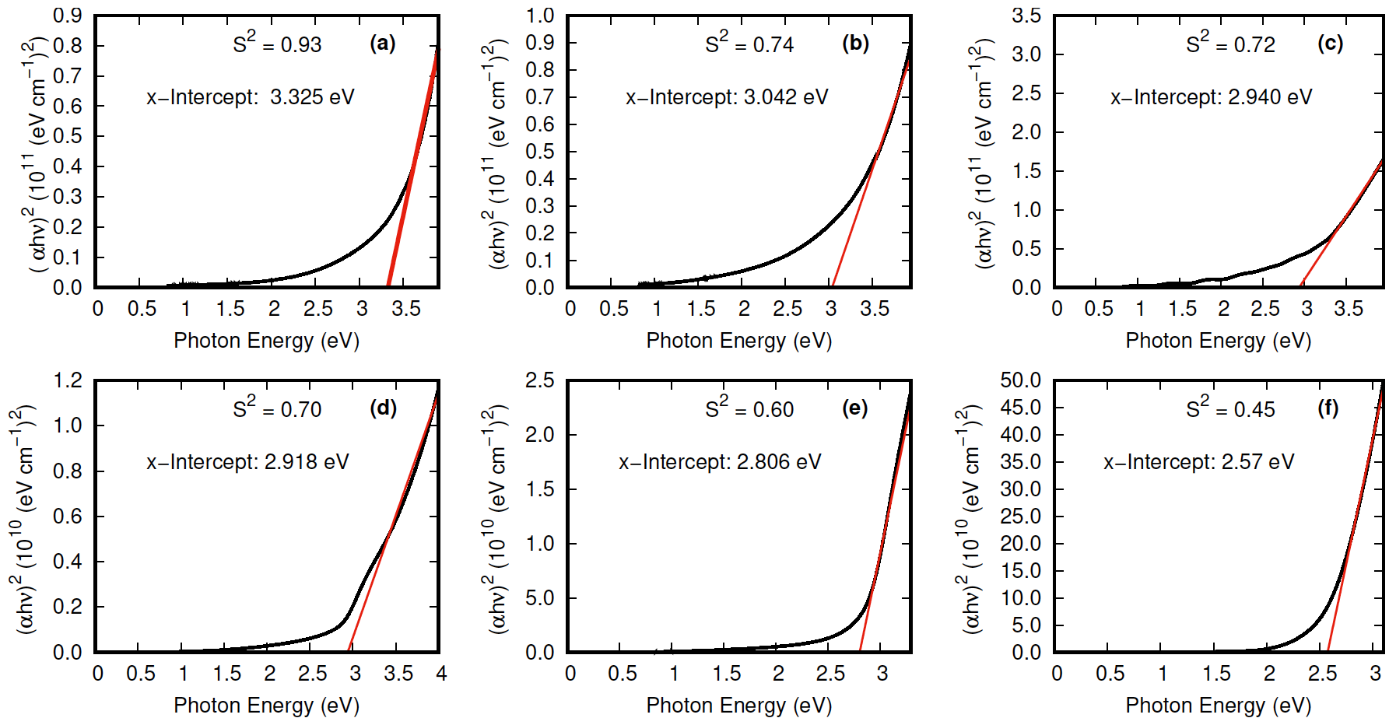
Optical Band Gap Measurements
Tauc plots to determine optical band gap of each film
Predominantly ordered sublattices tend to have a larger optical band gap
Most alike to the orthorhombic structure
Close to the predicted optical band gap (3.43 eV)
Mostly disordered sublattices tend to have a smaller optical band gap
Most alike to the wurtzite crystal structure
Courtesy of Prof. Roger Reeves and Robert Makin
Notes:
GET RID OF LETTERS EVERYWHERE A) B) C)...
order these by S, label S
Show the 2 extremes again
Put S here too
<number>

Slide 27
Optical Band Gap Measurements
Tauc plots to determine optical band gap of each film
Courtesy of Prof. Roger Reeves and Robert Makin
Notes:
GET RID OF LETTERS EVERYWHERE A) B) C)...
order these by S, label S
Show the 2 extremes again
Put S here too
<number>

Slide 28
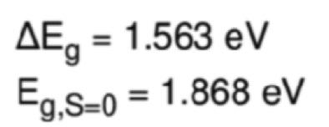
Order Parameter vs. Band Gap
Order parameters determined by RHEED, XRD, and Raman agree
Lattice properties dominated by pair interactions can be derived using an Ising model
One cation as spin up
Other cation as spin down
Linear relationship between optical band gap and S²
Ability to adjust the optical band gap continuously between red and UV without alloying
GaN
Notes:
better understood plotting band gap as a function of S2, applying the ising model
The ising model for the cation disorder predicts a linear trend between the optical band gap and S^2
<number>

Slide 29
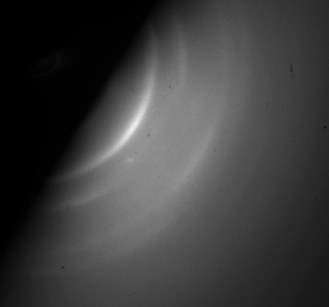
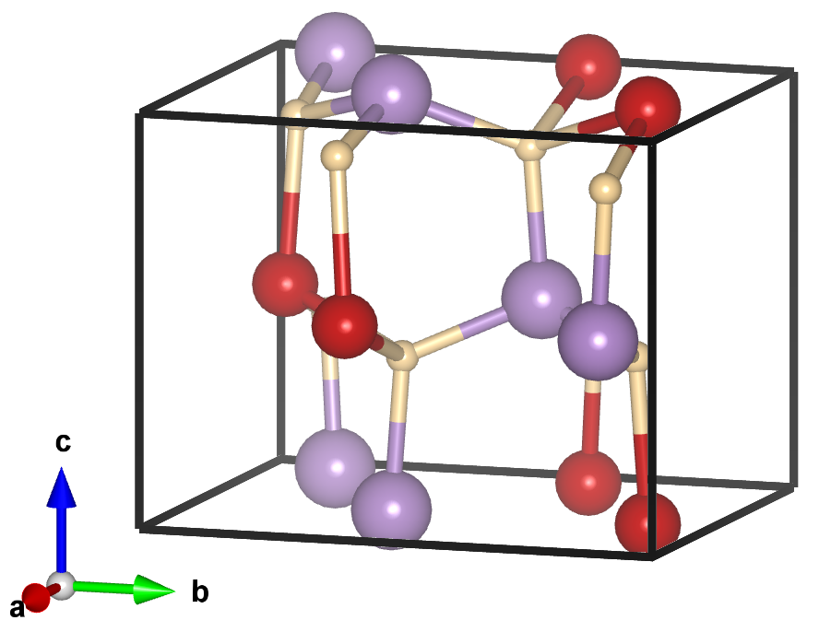
MgGeN₂
Substrate: YSZ(111)
Theoretical band gap: 5.14 eV

Slide 30
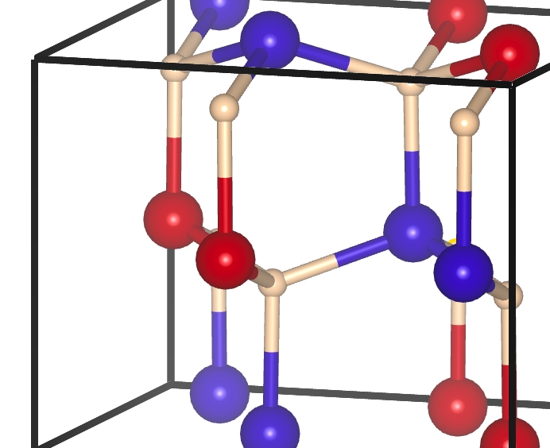
Conclusions
MgSnN₂ is a semiconductor comprised of inexpensive, earth abundant elements that have a strong recycling infrastructure
Determined parameters to synthesize material using PAMBE
Addressed lattice mismatch and substrate temperature problems
Experimentally measured lattice parameters match theoretically calculated
Optical band gap varies from 1.868 eV - 3.431 eV
Identified a robust correlation between optical band gap and S²
Notes:
In conclusion MgSnN2 is a semiconductor comprised of inexpensive, earth abundant elements that has a strong recycling infrastructure...
we need a MgGeN2 slide before this
delete 3rd bulllet point, keep story not how you got there
can do rheed, XRD, and raman
identified a robust correlation, optical BG and S2
give ACTUAL RANGE
<number>

